Slide 1
Python Data Structures

Slide 2
Outline
Stings – (is it DS?)
Lists
Dictionary
Tuple
Set

Slide 3
Object Identity and Equality (== vs is)
# Example of Object Identity
a = [1, 2, 3] # Creating a list
b = a # b references the same list object as a
print(a is b) # True, because both a and b point to the same object
print(id(a) == id(b)) # True, both have the same memory address
c = a[:] # c is a new list that is a copy of a
print(a is c) # False, c is a different object (different memory address)

Slide 4
Object Identity and Value Equality (== vs is)
# Example of Value Equality
x = [1, 2, 3] # Creating a list
y = [1, 2, 3] # Creating a different list with the same contents
print(x == y) # True, because the contents of x and y are equal
print(x is y) # False, because they are different objects in memory
z = x # z references the same object as x
print(x == z) # True, because they are the same object
print(x is z) # True, because they reference the same object

Slide 5
Object Identity and Equality (== vs is)
is checks if two variables point to the same object (identity).
== checks if two variables have the same value (equality).

Slide 6
num1 = 5
num2 = 5
lst1 = [1, 2, 3]
lst2 = [1, 2, 3]
lst3 = lst1
str1 = "hello world"
str2 = "hello world"
# using 'is' identity operator on different datatypes
print(num1 is num2)
print(lst1 is lst2)
print(lst1 is lst3)
print(str1 is str2)

Slide 7
Print as statement vs function vs Pprint
In Python 2 -> print "Hello, world!“ # It was just and statement not the function
In Python 3, print is a function, which requires parentheses. This change was made to improve consistency and flexibility. For example:
# Python 3 print("Hello, world!")
Pprint stands for pretty-print

Slide 8
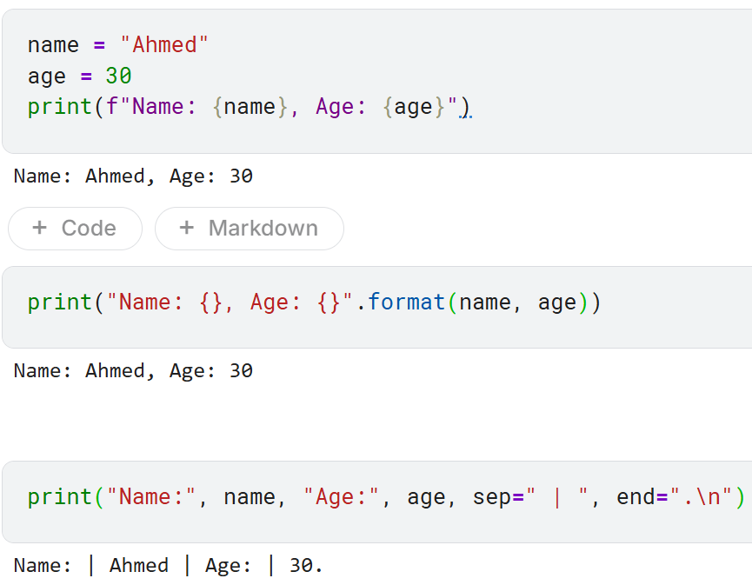

Slide 9
Print as statement vs function vs Pprint
The pprint function, provided by the pprint module, stands for "pretty-print".
It is used to print data structures like dictionaries and lists in a more readable format, especially useful for nested structures.

Slide 10
Print as statement vs function vs Pprint
Try this
data = {'name': ‘Ahmed', 'age': 30, 'city’: Nanchong'}
print(data)
Now Try this
from pprint import pprint
data = {'name': ‘Ahmed', 'age': 30, 'city’: ‘Nanchong', 'hobbies': ['reading’, ‘writing', 'coding’,’thinking’]}
pprint(data)

Slide 11
Print as statement vs function vs Pprint
You can customize pprint by creating an instance of PrettyPrinter and adjusting its parameters:
indent: Specifies the number of spaces to indent.
width: Specifies the maximum width of the output.
depth: Specifies the maximum depth to print nested structures.
compact: If set to True, it will try to fit more data into each line.
Now Try this
pp = PrettyPrinter(indent=4, width=40, depth=2, compact=True)
pp.pprint(data)

Slide 12
Overview on Strings
So far, we have seen how to define strings, get them as input, assign them to variables, and print them out
Unfortunately, this is not quite enough to do any serious text-based computing!
For this, we need some more string operations (which we know some already) and functions

Slide 13
Overview on Strings
strings are indeed a fundamental data structure in Python. They are used to represent and manipulate text. Here are a few key points about strings in Python:
Definition: A string is a sequence of characters enclosed in single quotes ('), double quotes ("), or triple quotes (''' or """).
Immutability: Strings in Python are immutable, meaning once they are created, their content cannot be changed.
Common Operations:
Concatenation: Joining two or more strings using the + operator.
Repetition: Repeating a string multiple times using the * operator.
Slicing: Extracting a part of a string using slice notation (string[start:end]).
Methods: Python provides many built-in methods for string manipulation, such as .upper(), .lower(), .replace(), .find(), and .split().

Slide 14
Indexing Strings
Recall that a string is a sequence of characters, which can be thought of as being stored in numbered buckets, starting from the left with 0
Individual characters that make up the string can then be accessed through the operation of indexing
H | E | L | L | O
0
1
2
3
4
>>> s = "HELLO"
>>> s[0]
'H'
>>>

Slide 15
Indexing Strings
Notice that in a string of n characters, the last character is at position n-1, because the indexes start at 0
H | E | L | L | O
0
1
2
3
4
>>> s = "HELLO"
>>> s[4]
'O'
>>> s[5]
Traceback (most recent call last): File "<stdin>", line 1, in <module> IndexError: string index out of range
>>>
Accessing the bucket at position n (or more) will result in an IndexError

Slide 16
Indexing Strings
We can also index a string from the right end using a negative number, after which Python will add the length of the string to the number and index the string at the resultant number (or position)
-1 + 5 (i.e., the length of the string) = 4
-5
-4
-3
-2
-1
H | E | L | L | O
0
1
2
3
4
>>> s = "HELLO"
>>> s[-1]
'O'
>>> s[-5]
'H'
>>>

Slide 17
Slicing Strings
Aside from indexing, which returns a string containing a single character from a larger string, it is also possible to access a contiguous sequence of characters (or a substring) from a string
In Python, this is accomplished through an operation called slicing, which takes the form <string>[<start>:<end>]
start and end should be int-valued expressions
Slicing returns the substring starting at start and running up to, but not including, end

Slide 18
Slicing Strings
Examples:
H | E | L | L | O |  | W | O | R | L | D
0
1
2
3
4
5
6
7
8
9
10
>>> greet = "HELLO WORLD"
>>> greet[0:5]
'HELLO'
>>> greet[6:11]
'WORLD'
>>> greet[:5]
'HELLO'
0 is assumed as the default if start is missing

Slide 19
Slicing Strings
More examples:
H | E | L | L | O |  | W | O | R | L | D
0
1
2
3
4
5
6
7
8
9
10
Last position is assumed as the default if end is missing
>>> greet[6:]
'WORLD'
>>> greet[:]
'HELLO WORLD'
>>>

Slide 20
Concatenating and Repeating Strings
The string data type also supports concatenation (+) and repetition (*) operations for putting strings together
Concatenation (which we’ve seen before) builds a string by ”gluing” two strings together
Repetition builds a string by multiple concatenations of a string with itself
>>> s1 = "Hello "
>>> s2 = "World "
>>> s3 = s1 + s2
>>> s3
'Hello World '
>>> s4 = s3 * 2
>>> s4
'Hello World Hello World '
>>>

Slide 21
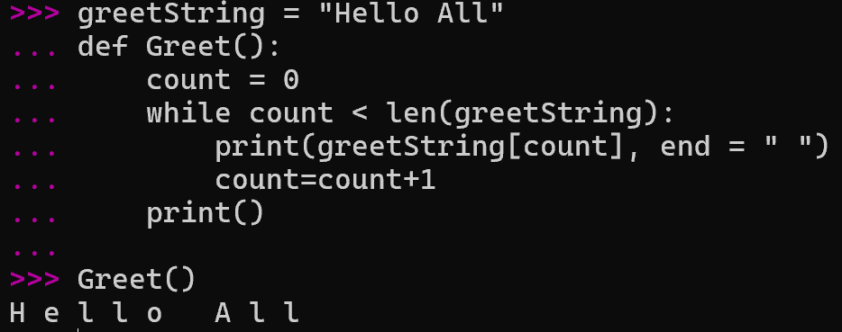
Getting the Length and Iterating Over Strings
Another useful function is len(), which tells how many characters are in a string
As seen before, we can also iterate over the characters of a string

Slide 22
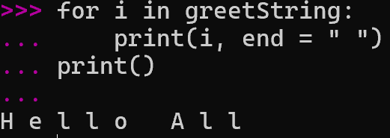
Getting the Length and Iterating Over Strings
for i in greet:
print(i, end = " ")
This for loop is equivalent to the earlier while loop
H e l l o A l l
H e l l o A l l
Output:

Slide 23
Summary of the Basic String Operations
The following table summarizes the basic string operations
Operator | Meaning
+ | Concatenation
* | Repetition
<string>[] | Indexing
<string>[ : ] | Slicing
len(<string>) | Length
for <var> in <string> | Iteration through characters

Slide 24
String Representation
How does computer process numbers and string, recall your concepts?
ASCII is American-centric
What about other languages?
Unicode is a much larger standard that includes support for the characters of nearly all written languages (ASCII is a subset of Unicode)
Python uses Unicode and provides a couple of built-in functions that allow us to switch back and forth between characters and their corresponding Unicode numeric values
The ord() function returns the numeric (“ordinal”) code of a single character
The chr() function goes the other direction

Slide 25
String Representation
Here are some interactive examples:
>>> ord("a")
97
>>> ord("b")
98
>>> ord("z")
122
>>> ord("A")
65
>>>
>>> ord("D")
68
>>> ord("Z")
90
>>> chr(90)
'Z'
>>> chr(65)
'A'
>>>

Slide 26
Strings Are Immutable
Strings are immutable (i.e., cannot be changed after they are created)
>>> mystr1 = "Python strings are immutable"
>>> mystr1[0] = "X"
Traceback (most recent call last):
File "<stdin>", line 1, in <module>
TypeError: 'str' object does not support item assignment
>>> id(mystr1)
4362322688
>>> mystr1 = mystr1 + "!"
>>> id(mystr1)
4362323008
>>>
id() is a function that allows getting the memory address
of any object
Concatenating two strings generate a new string with a new memory address

Slide 27
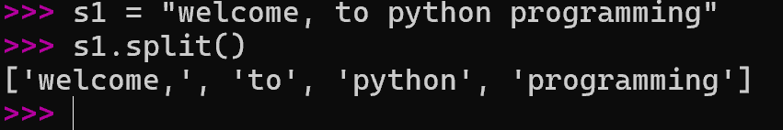
String Methods
Python has quite a few methods that string objects can call
For example, the split() method can be utilized to split a string into a list (more on this next lecture) of substrings
By default, split() will split the string wherever a space occurs
>>> s1 = "Hello, string methods!"
>>> s1.split()
['Hello,', 'string', 'methods!']
Referred to as a list

Slide 28
String Methods
The split() function can also be used to split a string at places other than spaces by supplying the character to split on as a parameter
For instance, if we have a string of numbers separated by commas, we could split on the commas as follows:
>>> "32,24,25,57".split(",")
['32', '24', '25', '57']
>>> "32,24,25,57".split()
['32,24,25,57']
>>>

Slide 29

String Methods
In general, the split() function has the following syntax:
Where:
Separator is the delimiter at which the string is split at (if it is not provided, white space will the separator)
Maxsplit is the number of splits that shall be performed on the string (if it is not provided, there will be no limit on the number of splits)
split(Separator, Maxsplit)

Slide 30
String Methods
Here are some interactive examples:
>>> mystr1 = "topic: string methods"
>>> mystr1.split(": ")
['topic', 'string methods']
>>> mystr2 = mystr1 + ": October, 2018"
>>> mystr2.split(": ")
['topic', 'string methods', 'October, 2018']
>>>
>>> mystr2.split(": ", 0)
['topic: string methods: October, 2018']
>>> mystr2.split(": ", 1)
['topic', 'string methods: October, 2018']
>>> mystr2.split(": ", 2)
['topic', 'string methods', 'October, 2018']
>>>

Slide 31
Some Other String Methods
Function | Meaning
s.capitalize() | Copy of s with only the first character capitalized
s.center(width) | Copy of s centered in a field of given width
s.count(sub) | Count the number of occurrences of sub in s
s.find(sub) | Find the first position where sub occurs in s
s.ljust(width) | Like center, but s is left-justified
s.lower() | Copy of s in all lowercase characters
s.lstrip() | Copy of s with leading white space removed

Slide 32
Some Other String Methods
Function | Meaning
s.replace(oldsub, newsub) | Replace all occurences of oldsub in s with newsub
s.rfind(sub) | Like find, but returns the rightmost position
s.rjust(width) | Like center, but s is right-justified
s.rstrip() | Copy of s with trailing white space removed
s.title() | Copy of s with first character of each word capitalized
s.upper() | Copy of s with all characters converted to uppercase

Slide 33
# Defining a string
greeting = "Hello, World!"
# Concatenation
full_greeting = greeting + " How are you?"
# Repetition
repeated_greeting = greeting * 2
# Slicing
hello = greeting[0:5]
# Using methods
upper_greeting = greeting.upper()
replaced_greeting = greeting.replace("World", "Python")
print(full_greeting)
print(repeated_greeting)
print(hello)
print(upper_greeting)
print(replaced_greeting)
Trace
the Output

Slide 34
# Defining a string
greeting = "Hello, World!"
# Concatenation
full_greeting = greeting + " How are you?"
# Repetition
repeated_greeting = greeting * 2
# Slicing
hello = greeting[0:5]
# Using methods
upper_greeting = greeting.upper()
replaced_greeting = greeting.replace("World", "Python")
print(full_greeting) # Output: Hello, World! How are you?
print(repeated_greeting) # Output: Hello, World!Hello, World!
print(hello) # Output: Hello
print(upper_greeting) # Output: HELLO, WORLD!
print(replaced_greeting) # Output: Hello, Python!

Slide 35
Overview on Lists
While strings are always sequences of characters, lists (or arrays as denoted in other languages) can be sequences of arbitrary objects
Hence, they are more general than strings
We can create a list of numbers or a list of strings or even a list of mixed numbers and strings via putting them in square brackets
myList1 = [1, 2, 3]
myList2 = [1.3, 4.5]
myList3 = [1, 2, 6.7]
myList4 = [“January”, “February”, “March”]
myList5 = [1, “January”, 2.3]

Slide 36
Reading
Decorator and generator in python

Slide 37
Creating Lists
In general, we can create lists via putting a number of expressions in square brackets
List = []
List = [expression, …]
E.g., List = [1+2, 7, “Eleven”]
List = [expression for variable in sequence], where expression is evaluated once for every element in the sequence (this is called ”list comprehension”)
E.g., List1 = [x for x in range(10)]
E.g., List2 = [x + 1 for x in range(10)]
E.g., List3 = [x for x in range(10) if x % 2 == 0]

Slide 38
Creating Lists
We can also use the built-in list type object to create lists:
L = list() #This creates an empty list
L = list([expression, …])
L = list(expression for variable in sequence)
>>> l1 = list()
>>> l1
[]
>>> type(l1)
<class 'list'>
>>> l2 = list(["A", 2.3])
>>> l2
['A', 2.3]

Slide 39
Creating Lists
We can also use the built-in list type object to create lists:
L = list() #This creates an empty list
L = list([expression, …])
L = list(expression for variable in sequence)
>>> type(l2)
<class 'list'>
>>> l3 = list(x for x in range(10))
>>> l3
[0, 1, 2, 3, 4, 5, 6, 7, 8, 9]
>>> type(l3)
<class 'list'>
>>>

Slide 40
Creating Lists
Python creates a single new list every time we use []
>>> L1 = [1, 2, 3]
>>> L2 = [1, 2, 3]
>>> L1 == L2
True
>>> L1 is L2
False
>>>
>>> L3 = L4 = [1, 2, 3]
>>> L3 == L4
True
>>> L3 is L4
True
>>>
L1 and L2 have the same values but they are independent lists (i.e., they do not point to the same list)
L3 and L4 point to the same list

Slide 41
Indexing and Concatenating Lists
Like strings, lists can be indexed and concatenated
>>> [1, 2] + [3, 4]
[1, 2, 3, 4]
>>> [1, 2] * 2
[1, 2, 1, 2]
>>> grades = ["A", "B", "C", "D", "F"]
>>> grades[0]
'A'
>>> len(grades)
5
>>>

Slide 42
Slicing Lists
Similar to strings as well, lists can be sliced
To slice elements within a range start_index and end_index (inclusive), we can use [start_index : end_index+1]
A | B | C | D | F
0
1
2
3
4
>>> grades = ["A", "B", "C", "D", "F"]
>>> grades[1:3]
['B', 'C']
>>>

Slide 43
Slicing Lists
To slice elements from the beginning to a certain ending index (inclusive), we can use [: end_index+1]
A | B | C | D | F
0
1
2
3
4
>>> grades = ["A", "B", "C", "D", "F"]
>>> grades[:3]
['A', 'B', 'C']
>>>

Slide 44
Slicing Lists
Similar to strings as well, lists can be sliced
To slice elements from a certain starting index till the end, we can use [start_index:]
A | B | C | D | F
0
1
2
3
4
>>> grades = ["A", "B", "C", "D", "F"]
>>> grades[1:]
['B', 'C', 'D', 'F']
>>>

Slide 45
Slicing Lists
Similar to strings as well, lists can be sliced
To slice all elements, we can use [:]
A | B | C | D | F
0
1
2
3
4
>>> grades = ["A", "B", "C", "D", "F"]
>>> grades[:]
['A', 'B', 'C', 'D', 'F']
>>>

Slide 46
Slicing Lists
Similar to strings as well, lists can be sliced
We can even pass a negative index, after which Python will add the length of the list to the index
-5
-4
-3
-2
-1
A | B | C | D | F
0
1
2
3
4
>>> grades = ["A", "B", "C", "D", "F"]
>>> grades[-1]
'F'
>>>

Slide 47
Slicing Lists
Similar to strings as well, lists can be sliced
To slice elements from a certain ending index (inclusive) till the beginning, we can use [:-end_index+1]
-5
-4
-3
-2
-1
A | B | C | D | F
0
1
2
3
4
>>> grades = ["A", "B", "C", "D", "F"]
>>> grades[:-1]
['A', 'B', 'C', 'D']
>>>

Slide 48
Slicing Lists
Similar to strings as well, lists can be sliced
To slice elements from a certain ending index (inclusive) till the beginning, we can use [:-end_index+1]
-5
-4
-3
-2
-1
A | B | C | D | F
0
1
2
3
4
If you want to start from -1 (inclusive), pass nothing to the ending index
>>> grades = ["A", "B", "C", "D", "F"]
>>> grades[:0]
[]
>>>
?

Slide 49
Slicing Lists
Similar to strings as well, lists can be sliced
To slice elements from a certain ending index (inclusive) till the beginning, we can use [:-end_index+1]
-5
-4
-3
-2
-1
A | B | C | D | F
0
1
2
3
4
>>> grades = ["A", "B", "C", "D", "F"]
>>> grades[:]
['A', 'B', 'C', 'D', 'F']
>>>

Slide 50
Slicing Lists
Similar to strings as well, lists can be sliced
To slice in steps, we can use [start_index, end_index+1, step] (idea applies to slicing from forward and backward)
-5
-4
-3
-2
-1
A | B | C | D | F
0
1
2
3
4
>>> grades = ["A", "B", "C", "D", "F"]
>>> grades[0:5:2]
['A', 'C', 'F']
>>>

Slide 51
Slicing Lists
Similar to strings as well, lists can be sliced
To slice in steps, we can use [start_index, end_index+1, step] (idea applies to slicing from forward and backward)
-5
-4
-3
-2
-1
A | B | C | D | F
0
1
2
3
4
>>> grades = ["A", "B", "C", "D", "F"]
>>> grades[::]
['A', 'B', 'C', 'D', 'F']
>>>

Slide 52
Slicing Lists
Similar to strings as well, lists can be sliced
To slice in steps, we can use [start_index, end_index+1, step] (idea applies to slicing from forward and backward)
-5
-4
-3
-2
-1
A | B | C | D | F
0
1
2
3
4
>>> grades = ["A", "B", "C", "D", "F"]
>>> grades[::-1]
['F', 'D', 'C', 'B', 'A']
>>>
It slices elements in reverse order!

Slide 53
Lists Are Mutable
Unlike strings, lists are mutable
I.e., the value of an item in a list can be changed “in place” with an assignment statement
>>> myList = [1, 2, 3]
>>> myList[0]
1
>>> myList[0] = 56
>>> myList[0]
56
>>> myList
[56, 2, 3]
>>>

Slide 54
Lists Are Not Sets
Lists can have duplicate values
We can also iterate over the items of any list
>>> myList = [5, 2, 2, 3]
>>> myList
[5, 2, 2, 3]
>>>
myList = [1, 2, 3, 4, 5]
for i in myList:
print(i, end = " ")
print()

Slide 55
Multi-Dimensional Lists
Lists can be nested so as to create a multi-dimensional list
>>> myList = [[1, 2, 3], [4, 5, 6]]
>>> myList
[[1, 2, 3], [4, 5, 6]]
>>> myList[0]
[1, 2, 3]
>>> myList[0][0]
1
>>> myList[0][1]
2
>>> myList[1][0]
4
>>>

Slide 56
Multi-Dimensional Lists
How can we iterate over the elements of a n-dimensional list?
By using n loops
my2DList = [[1, 2, 3], [4, 5, 6]]
for i in my2DList:
for j in my2DList[i]:
print(j, end = " ")
print()
my1DList = [1, 2, 3]
for i in my1DList:
print(i, end = " ")
print()
i is a list here!
Output: 1 2 3
ERROR: list indices must be integers or slices, not lists

Slide 57
Multi-Dimensional Lists
How can we iterate over the elements of a n-dimensional list?
By using n loops
my2DList = [[1, 2, 3], [4, 5, 6]]
for i in range(len(my2DList)):
for j in range(len(my2DList[i])):
print(my2DList[i][j], end = " ")
print()
1 2 3
4 5 6
Output:

Slide 58
Adding Elements To a List
Elements can be added to a list using the built-in append() function
myList = []
print(myList)
myList.append(1)
myList.append(2)
myList.append("Done")
print(myList)
[]
[1, 2, 'Done']
Output:

Slide 59
Adding Elements To a List
The append() function allows adding only 1 element at a time
For adding multiple elements with the append() function, loops can be used
myList = []
for i in range(1, 4):
myList.append(i)
print(myList)
Output:
[1, 2, 3]

Slide 60
Adding Elements To a List
We can also use the append() function to add a list to a list
myList1 = [1, 2]
myList2 = [3, 4]
print("myList1 before:", myList1)
myList1.append(myList2)
print("myList1 after:", myList1)
[1, 2]
[3, 4, [1, 2]]
Output:

Slide 61
Adding Elements To a List
But, what if we want to add the multiple elements of a list (and NOT the list itself) to the end of another list?

Slide 62
Adding Elements To a List
But, what if we want to add the multiple elements of a list (and NOT the list itself) to the end of another list?
Of course, we can use loops as usual
Or, we can simply use the extend() function
myList1 = [1, 2]
myList2 = [3, 4]
print("myList1 before:", myList1)
myList1.extend(myList2)
print("myList1 after:", myList1)
myList1 before: [1, 2]
myList1 after: [1, 2, 3, 4]
Output:

Slide 63
Adding Elements To a List
The append() and extend() functions allow adding elements only at the end of a list
What if we want to add elements at desired positions of a list?
Of course, we can use loops as usual (not straightforward!)
Or, we can simply use the insert() function, which requires two arguments, insert(position, value)

Slide 64
Adding Elements To a List
An example that uses the insert() function to add elements at desired positions in a list
myList = [2, 4]
print(myList)
myList.insert(0, 1)
print(myList)
myList.insert(2, 3)
print(myList)
Output:
[2, 4]
[1, 2, 4]
[1, 2, 3, 4]

Slide 65
Removing Elements From a List
Elements can be removed from a list one at a time using the built-in function remove(elem)
If elem is not in the list, an error will be issued
myList = [100, 200, 300, 400, 200, "Python"]
print(myList)
myList.remove(200)
print(myList)
Output:
[100, 200, 300, 400, 200, 'Python']
[100, 300, 400, 200, 'Python']
Only the first occurrence of the element is removed!

Slide 66
Removing Elements From a List
To remove an element at a certain position i, pop(i) can be used
pop() with no argument is valid, but it will remove the last element in the list
myList = [100, 200, 300, 400, 200, "Python"]
print(myList)
myList.pop(4)
print(myList)
myList.pop()
print(myList)
Output:
[100, 200, 300, 400, 200, 'Python']
[100, 200, 300, 400, 'Python']
[100, 200, 300, 400]

Slide 67
List Functions
Here is the set of functions that you can use with lists
Function | Description
L.append(x) | Add element x to the end of list L
L.extend(L2) | Add all elements of list L2 to the end of list L
L.insert(i, x) | Insert item x at the defined index i of list L
L.remove(x) | Removes item x from list L (valueError exception will be thrown if x does not exist)
L.pop(i) | Removes and returns the element at index i of list L. If no parameter is passed, the last item in L will be removed and returned

Slide 68
List Functions
Here is the set of functions that you can use with lists
Function | Description
L.clear() | Removes all items from list L
L.index(x) | Returns the index of the first matched item x in list L
L.count(x) | Returns the count of times item x appears in list L
L.sort() | Sort items in list L in an ascending order
L.reverse() | Reverses the order of items in list L
L.copy() | Returns a copy of list L (making any change to the returned list will not impact the original list L)

Slide 69
Quick Question
[x**2 for x in range(10)]
What does the following code return: sum([1, 2, 3, 4, 5])?
Sum([x for x in range(1,6)])
What is the output of [x * 2 for x in [1, 2, 3]]?
What is the result of [x for x in range(10) if x > 5]?
my_list = [5,1,2,9,10]
my_list.sort()
list = [(x, y) for x in range(3) for y in range(3)]
print(list)
Notes:
# Output: [(0, 0), (0, 1), (0, 2), (1, 0), (1, 1), (1, 2), (2, 0), (2, 1), (2, 2)]

Slide 70
Example: Matrix-Matrix Addition
A matrix is a rectangular (2D) list of numbers or other mathematical objects for which operations (e.g., addition/subtraction) are defined
It is used in various real-world applications (e.g., image processing, graph theory, physics, probability and statistics, etc.)
# of columns = n = 5
0 | 1 | 2 | 3 | 4
0
1
2
3
4
1 | 4 | 7 | 9 | 12
10 | 7 | 55 | 12 | 13
7 | 81 | 90 | 17 | 8
11 | 2 | 3 | 1 | 66
34 | 52 | 97 | 8 | 22
An m×n Matrix with m = 5 rows and n = 5 columns (this is referred to as square matrix since m = n)
# of rows = m = 5

Slide 71
Example: Matrix-Matrix Addition
1 | 4 | 7 | 9 | 12
10 | 7 | 55 | 12 | 13
7 | 81 | 90 | 17 | 8
11 | 2 | 3 | 1 | 66
34 | 52 | 97 | 8 | 22
1 | 2 | 3 | 4 | 5
6 | 7 | 8 | 9 | 10
11 | 12 | 13 | 14 | 15
16 | 17 | 18 | 19 | 20
21 | 22 | 23 | 24 | 25
+
=
5×5 Matrix A
5×5 Matrix B
5×5 Matrix C

Slide 72
Example: Matrix-Matrix Addition
1 | 4 | 7 | 9 | 12
10 | 7 | 55 | 12 | 13
7 | 81 | 90 | 17 | 8
11 | 2 | 3 | 1 | 66
34 | 52 | 97 | 8 | 22
1 | 2 | 3 | 4 | 5
6 | 7 | 8 | 9 | 10
11 | 12 | 13 | 14 | 15
16 | 17 | 18 | 19 | 20
21 | 22 | 23 | 24 | 25
2
+
=
5×5 Matrix A
5×5 Matrix B
5×5 Matrix C

Slide 73
Example: Matrix-Matrix Addition
1 | 4 | 7 | 9 | 12
10 | 7 | 55 | 12 | 13
7 | 81 | 90 | 17 | 8
11 | 2 | 3 | 1 | 66
34 | 52 | 97 | 8 | 22
1 | 2 | 3 | 4 | 5
6 | 7 | 8 | 9 | 10
11 | 12 | 13 | 14 | 15
16 | 17 | 18 | 19 | 20
21 | 22 | 23 | 24 | 25
2 | 6
+
=
5×5 Matrix A
5×5 Matrix B
5×5 Matrix C

Slide 74
Example: Matrix-Matrix Addition
1 | 4 | 7 | 9 | 12
10 | 7 | 55 | 12 | 13
7 | 81 | 90 | 17 | 8
11 | 2 | 3 | 1 | 66
34 | 52 | 97 | 8 | 22
1 | 2 | 3 | 4 | 5
6 | 7 | 8 | 9 | 10
11 | 12 | 13 | 14 | 15
16 | 17 | 18 | 19 | 20
21 | 22 | 23 | 24 | 25
2 | 6 | 10
+
=
5×5 Matrix A
5×5 Matrix B
5×5 Matrix C

Slide 75
Example: Matrix-Matrix Addition
1 | 4 | 7 | 9 | 12
10 | 7 | 55 | 12 | 13
7 | 81 | 90 | 17 | 8
11 | 2 | 3 | 1 | 66
34 | 52 | 97 | 8 | 22
1 | 2 | 3 | 4 | 5
6 | 7 | 8 | 9 | 10
11 | 12 | 13 | 14 | 15
16 | 17 | 18 | 19 | 20
21 | 22 | 23 | 24 | 25
2 | 6 | 10 | 13
+
=
5×5 Matrix A
5×5 Matrix B
5×5 Matrix C

Slide 76
Example: Matrix-Matrix Addition
1 | 4 | 7 | 9 | 12
10 | 7 | 55 | 12 | 13
7 | 81 | 90 | 17 | 8
11 | 2 | 3 | 1 | 66
34 | 52 | 97 | 8 | 22
1 | 2 | 3 | 4 | 5
6 | 7 | 8 | 9 | 10
11 | 12 | 13 | 14 | 15
16 | 17 | 18 | 19 | 20
21 | 22 | 23 | 24 | 25
2 | 6 | 10 | 13 | 17
+
=
5×5 Matrix A
5×5 Matrix B
5×5 Matrix C

Slide 77
Example: Matrix-Matrix Addition
1 | 4 | 7 | 9 | 12
10 | 7 | 55 | 12 | 13
7 | 81 | 90 | 17 | 8
11 | 2 | 3 | 1 | 66
34 | 52 | 97 | 8 | 22
1 | 2 | 3 | 4 | 5
6 | 7 | 8 | 9 | 10
11 | 12 | 13 | 14 | 15
16 | 17 | 18 | 19 | 20
21 | 22 | 23 | 24 | 25
2 | 6 | 10 | 13 | 17
16 | 14 | 63 | 21 | 23
+
=
5×5 Matrix A
5×5 Matrix B
5×5 Matrix C

Slide 78
Example: Matrix-Matrix Addition
1 | 4 | 7 | 9 | 12
10 | 7 | 55 | 12 | 13
7 | 81 | 90 | 17 | 8
11 | 2 | 3 | 1 | 66
34 | 52 | 97 | 8 | 22
1 | 2 | 3 | 4 | 5
6 | 7 | 8 | 9 | 10
11 | 12 | 13 | 14 | 15
16 | 17 | 18 | 19 | 20
21 | 22 | 23 | 24 | 25
2 | 6 | 10 | 13 | 17
16 | 14 | 63 | 21 | 23
18 | 93 | 103 | 31 | 23
+
=
5×5 Matrix A
5×5 Matrix B
5×5 Matrix C

Slide 79
Example: Matrix-Matrix Addition
1 | 4 | 7 | 9 | 12
10 | 7 | 55 | 12 | 13
7 | 81 | 90 | 17 | 8
11 | 2 | 3 | 1 | 66
34 | 52 | 97 | 8 | 22
1 | 2 | 3 | 4 | 5
6 | 7 | 8 | 9 | 10
11 | 12 | 13 | 14 | 15
16 | 17 | 18 | 19 | 20
21 | 22 | 23 | 24 | 25
2 | 6 | 10 | 13 | 17
16 | 14 | 63 | 21 | 23
18 | 93 | 103 | 31 | 23
27 | 19 | 21 | 20 | 86
+
=
5×5 Matrix A
5×5 Matrix B
5×5 Matrix C

Slide 80
Example: Matrix-Matrix Addition
1 | 4 | 7 | 9 | 12
10 | 7 | 55 | 12 | 13
7 | 81 | 90 | 17 | 8
11 | 2 | 3 | 1 | 66
34 | 52 | 97 | 8 | 22
1 | 2 | 3 | 4 | 5
6 | 7 | 8 | 9 | 10
11 | 12 | 13 | 14 | 15
16 | 17 | 18 | 19 | 20
21 | 22 | 23 | 24 | 25
2 | 6 | 10 | 13 | 17
16 | 14 | 63 | 21 | 23
18 | 93 | 103 | 31 | 23
27 | 19 | 21 | 20 | 86
55 | 74 | 120 | 32 | 47
+
=
5×5 Matrix A
5×5 Matrix B
5×5 Matrix C
Matrix-matrix subtraction follows exactly the same flow as matrix-matrix addition, but with the (–) operation being applied between every two elements instead of the (+) operation

Slide 81
Example: Matrix-Matrix Addition
import random
def buildSquareMatrix(m, n):
if m == n:
matrix = []
for i in range(m):
r = []
for j in range(n):
r.append(random.randint(1, 100))
matrix.append(r)
return matrix
else:
return "This function builds only square matrices with random integers\n"

Slide 82
Example: Matrix-Matrix Addition
#This function assumes equal square matrices (i.e., each matrix is a square matrix
#and both have the same numbers of rows and columns)
def addMatrices(a, b):
m = n = len(a)
c = []
for i in range(m):
r = []
for j in range(n):
r.append(a[i][j] + b[i][j])
c.append(r)
return c

Slide 83
Example: Matrix-Matrix Addition
def printMatrix(a):
for i in a:
for j in i:
print(j, end = "\t")
print()
print()
a = buildSquareMatrix(5, 5)
b = buildSquareMatrix(5, 5)
printMatrix(a)
printMatrix(b)
c = addMatrices(a, b)
printMatrix(c)

Slide 84
Tuples
Tuples are very similar to lists, but they are immutable (i.e., unchangeable)
Tuples are written with round brackets as follows:
t1 = (1, 2, 3)
t2 = (“a”, “b”, “c”, ”d”)
t3 = (200, “A”, [4, 5], 3.2)
print(t1)
print(t2)
print(t3)

Slide 85
Tuples
Like lists, tuples can:
Contain any and different types of elements
Contain duplicate elements (e.g., (1, 1, 2))
Be indexed exactly in the same way (i.e., using the [] brackets)
Be sliced exactly in the same way (i.e., using the [::] notation)
Be concatenated (e.g., t = (1, 2, 3) + (“a”, “b”, “c”))
Be repeated (e.g., t = (“a”, “b”) * 10)
Be nested (e.g., t = ((1, 2), (3, 4), ((“a”, “b”, ”c”), 3.4))
Be passed to a function, but will result in pass-by-value and not pass-by-reference outcome since it is immutable
Be iterated over

Slide 86
Examples
This will print the elements of t1 in
a reversed order, but will not change
t1 itself since it is immutable
t1 = ("a", "b", "c")
print(t1[::-1])
t2 = ("a", "b", "c")
t3 = t1 + t2
print(t3)
t3 = t3 * 4
print(t3)
for i in t3:
print(i, end = " ")
print()
This will concatenate t1 and t2 and assign the result to t3 (again, t1 and t2 will be unchanged since they are immutable)
This will repeat t3 four times and assign the result to t3. Hence,
t3 will be overwritten (i.e., NOT changed in place- because it is immutable-, but redefined with a new value)

Slide 87
Examples
This is an example of nesting, where a matrix with 2 rows and 3 columns is created. The first row includes the elements 1, 2, and 3. The second row includes the elements “a”, “b”, and “c”.
t4 = ((1, 2, 3), ("a", "b", "c"))
for j in t4:
for k in j:
print(k,end = " ")
print()
This outer loop iterates over each element in t4; that is, it gets first the element (1, 2, 3) and second the element (“a”, “b”, “c”)
This inner loop iterates over each element read by the outer loop; that is, it first iterates over the elements of the element (1, 2, 3), and second it iterates over the elements of the element (“a”, “b”, “c”)

Slide 88
Examples
This change on t remains local to the function since a value of t was passed and not a reference to it
def func1(t):
t = t * 2
t = (1, 2, 3)
print(t)
func1(t)
print(t)
This will output (1, 2, 3)
This will also output (1, 2, 3) since tuples are immutable, hence, will always exhibit a passed-by-value behavior

Slide 89
Using Functions with Tuples
You can also use functions with tuples
The count(x) function returns the number of elements with the specified value x (e.g., x is 1 in this example)
t1 = (1, 2, 3, 1, 5, 1)
print(t1.count(1))
print(t1.index(1))
Output:
3
0
The index(x) function returns the index of the first element with the specified value x (e.g., x is 1 in this example)
In fact, Python has only these two built-in functions that can be used on tuples

Slide 90
Towards Dictionaries
Lists and tuples hold elements with only integer indices
So in essence, each element has an index (or a key) which can only be an integer, and a value which can be of any type (e.g., in the above list/tuple, the first element has key 0 and value 45)
What if we want to store elements with non-integer indices (or keys)?
45 | “Coding” | 4.5 | 7 | 89
Integer Indices
0 | 1 | 2 | 3 | 4

Slide 91
Dictionaries
In Python, you can use a dictionary to store elements with keys of any types (not necessarily only integers like lists and tuples) and values of any types as well
The above dictionary can be defined in Python as follows:
dic = {"NUM":45, 1000:"coding", 2000:4.5, 3.4:7, "XXX":89}
45 | “Coding” | 4.5 | 7 | 89
“NUM” | 1000 | 2000 | 3.4 | “XXX”
keys of different types
Values of different types
key
value
Each element is a key:value pair, and elements are separated by commas

Slide 92
Dictionaries
In summary, dictionaries:
Can contain any and different types of elements (i.e., keys and values)
Can contain only unique keys but duplicate values
Can be indexed but only through keys (i.e., dic2[“a”] will return 1 but dic2[0] will return an error since there is no element with key 0 in dic2 above)
dic2 = {"a":1, "a":2, "b":2}
print(dic2)
Output: {'a': 2, 'b': 2}
The element “a”:2 will override the element “a”:1
because only ONE element can have key “a”

Slide 93
Dictionaries
In summary, dictionaries:
CANNOT be concatenated
CANNOT be repeated
Can be nested (e.g., d = {"first":{1:1}, "second":{2:"a"}}
Can be passed to a function and will result in a pass-by-reference and not pass-by-value behavior since it is immutable (like lists)
def func1(d):
d["first"] = [1, 2, 3]
dic = {"first":{1:1}, "second":{2:"a"}}
print(dic)
func1(dic)
print(dic)
Output:
{'first': {1: 1}, 'second': {2: 'a'}}
{'first': [1, 2, 3], 'second': {2: 'a'}}

Slide 94
Dictionaries
In summary, dictionaries:
Can be iterated over
dic = {"first": 1, "second": 2, "third": 3}
for i in dic:
print(i)
first
second
third
ONLY the keys will be returned.
Output:
How to get the values?

Slide 95
Dictionaries
In summary, dictionaries:
Can be iterated over
dic = {"first": 1, "second": 2, "third": 3}
for i in dic:
print(dic[i])
1
2
3
Output:
Values can be accessed via indexing!

Slide 96
Adding Elements to a Dictionary
How to add elements to a dictionary?
By indexing the dictionary via a key and assigning a corresponding value
dic = {"first": 1, "second": 2, "third": 3}
print(dic)
dic["fourth"] = 4
print(dic)
{'first': 1, 'second': 2, 'third': 3}
{'first': 1, 'second': 2, 'third': 3, 'fourth': 4}
Output:

Slide 97
Adding Elements to a Dictionary
How to add elements to a dictionary?
By indexing the dictionary via a key and assigning a corresponding value
dic = {"first": 1, "second": 2, "third": 3}
print(dic)
dic[”second"] = 4
print(dic)
If the key already exists, the value will be overridden
{'first': 1, 'second': 2, 'third': 3}
{'first': 1, 'second’: 4, 'third': 3}
Output:

Slide 98
Deleting Elements to a Dictionary
How to delete elements in a dictionary?
By using del
dic = {"first": 1, "second": 2, "third": 3}
print(dic)
dic["fourth"] = 4
print(dic)
del dic["first"]
print(dic)
Output:
{'first': 1, 'second': 2, 'third': 3}
{'first': 1, 'second': 2, 'third': 3, 'fourth': 4}
{'second': 2, 'third': 3, 'fourth': 4}

Slide 99
Deleting Elements to a Dictionary
How to delete elements in a dictionary?
Or by using the function pop(key)
dic = {"first": 1, "second": 2, "third": 3}
print(dic)
dic["fourth"] = 4
print(dic)
dic.pop(“first”)
print(dic)
Output:
{'first': 1, 'second': 2, 'third': 3}
{'first': 1, 'second': 2, 'third': 3, 'fourth': 4}
{'second': 2, 'third': 3, 'fourth': 4}

Slide 100
Dictionary Functions
Many other functions can also be used with dictionaries
Function | Description
dic.clear() | Removes all the elements from dictionary dic
dic.copy() | Returns a copy of dictionary dic
dic.items() | Returns a list containing a tuple for each key-value pair in dictionary dic
dic.get(k) | Returns the value of the specified key k from dictionary dic
dic.keys() | Returns a list containing all the keys of dictionary dic
dic.pop(k) | Removes the element with the specified key k from dictionary dic

Slide 101
Dictionary Functions
Many other functions can also be used with dictionaries
Function | Description
dic.popitem() | Removes the last inserted key-value pair in dictionary dic
dic.values() | Returns a list of all the values in dictionary dic

Slide 102
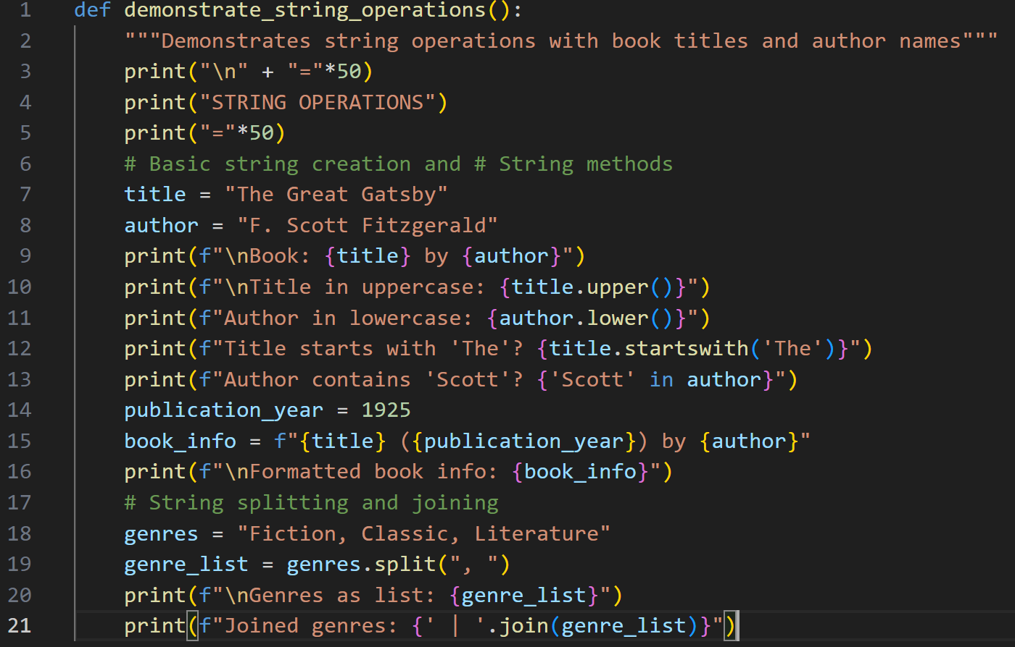

Slide 103
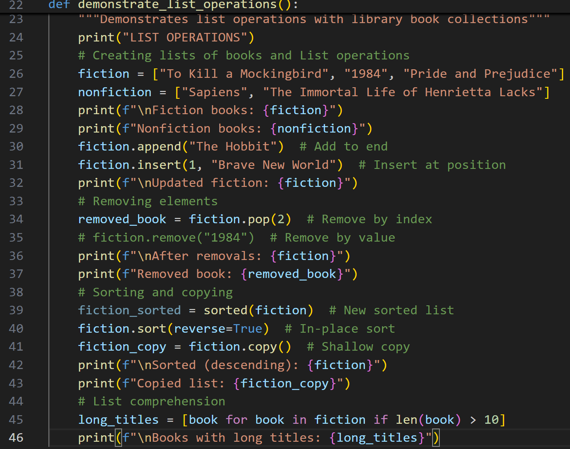

Slide 104
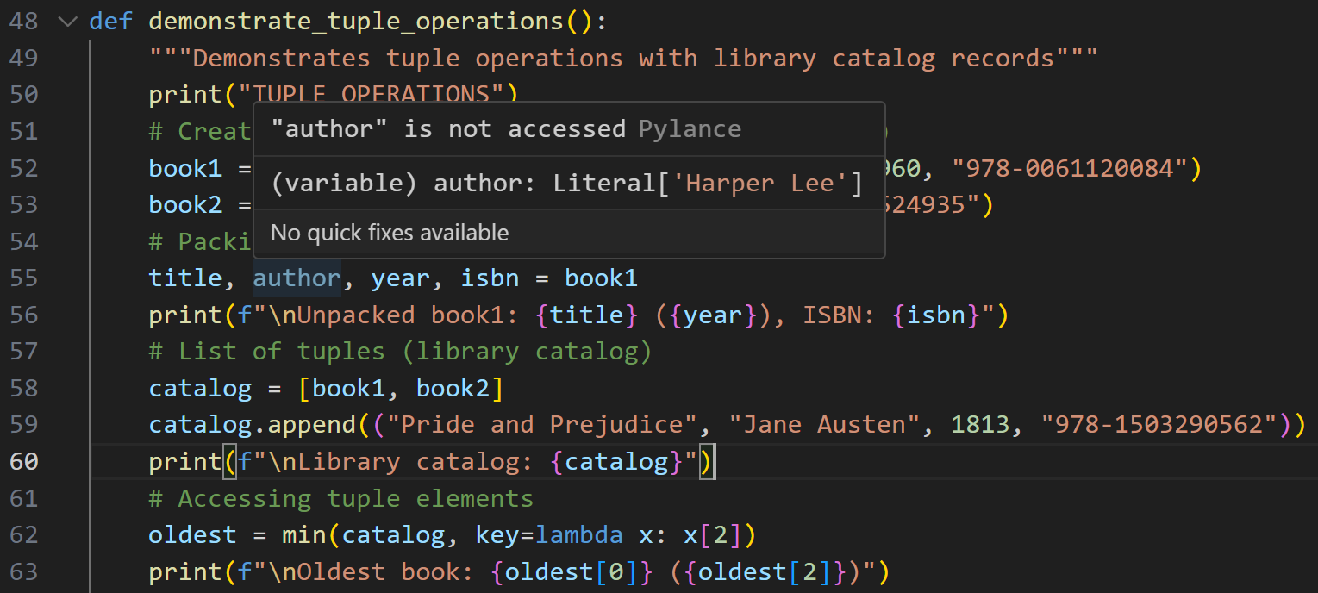

Slide 105
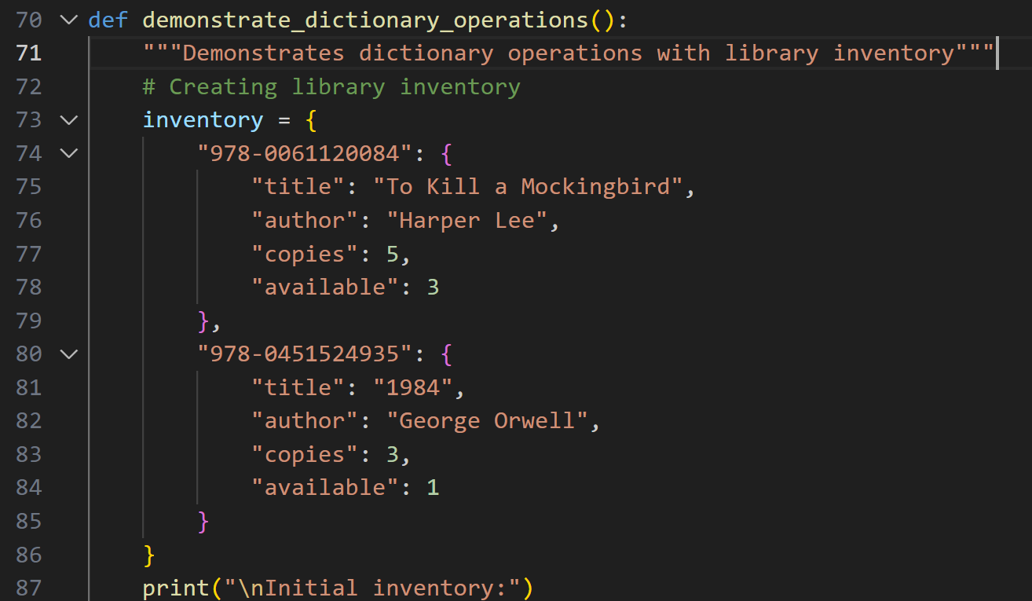

Slide 106
